Slide 1
CS 31006: Computer Networks – The Internet Transport Protocols

Slide 2
Transmission Control Protocol (TCP)
TCP was specifically designed to provide a reliable, end-to-end byte stream over an unreliable internetwork.
Internetwork – different parts may have widely different topologies, bandwidths, delays, packet sizes and other parameters
TCP dynamically adapts to properties of the internetwork and is robust in the face of many kinds of failures.
RFC 793 (September 1981) – Base protocol
RFC 1122 (clarifications and bug fixes), RFC 1323 (High performance), RFC 2018 (SACK), RFC 2581 (Congestion Control), RFC 3168 (Explicit Congestion Notification)

Slide 3
TCP Service Model
Uses Sockets to define an end-to-end connection (Source IP, Source Port, Source Initial Sequence Number, Destination IP, Destination Port, Destination Initial Sequence Number)
Unix Model of Socket Implementation:
A single daemon process, called Internet Daemon (inetd) runs all the times at different well known ports, and wait for the first incoming connection
When a first incoming connection comes, inetd forks a new process and starts the corresponding daemon (for example httpd at port 80, ftpd at port 21 etc.)
All TCP connections are full-diplex and point-to-point. TCP does not support multicasting or broadcasting.

Slide 4
TCP Service Model
A TCP connection is a byte stream, not a message stream
Message boundaries are not preserved end-to-end
Example:
The sending process does four 512 byte writes to a TCP stream – for write() call to the TCP socket
These data may be delivered as – four 512 byte chunks, two 1024 byte chunks, one 2048 byte chunk or some other way
There is no way for the receiver to detect the unit(s) in which the data were written by the sending process.

Slide 5
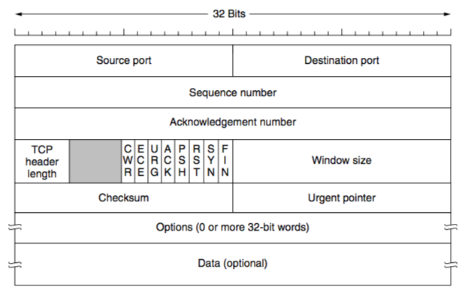
The TCP Protocol – The Header
Source: Computer Networks (5th Edition) by Tanenbaum, Wetherell

Slide 6
TCP Sequence Number and Acknowledgement Number
32 bits sequence number and acknowledgement number
Every byte on a TCP connection has its own 32 bit sequence number – a byte stream oriented connection
TCP uses sliding window based flow control – the acknowledgement number contains next expected byte in order, which acknowledges the cumulative bytes that has been received by the receiver.
ACK number 31245 means that the receiver has correctly received up to 31244 bytes and expecting for byte 31245

Slide 7
TCP Segments
The sending and receiving TCP entities exchange data in the form of segments.
A TCP segment consists of a fixed 20 byte header (plus an optional part) followed by zero or more data bytes.
TCP can accumulate data from several write() calls into one segment, or split data from one write() into multiple segments
A segment size is restricted by two parameters
IP Payload (65515 bytes)
Maximum Transmission Unit (MTU) of the link

Slide 8
How a TCP Segment is Created
Write() calls from the applications write data to the TCP sender buffer.
sender maintains a dynamic window size based on the flow and congestion control algorithm
Modern implementations of TCP uses path MTU discovery to determine the MTU of the end-to-end path (uses ICMP protocol), and sets up the Maximum Segment Size (MSS) during connection establishment
May depend on other parameters (buffer implementation).
Check the sender window after receiving an ACK. If the window size is less than MSS, construct a single segment; otherwise construct multiple segments, each equals to the MSS

Slide 9
Challenges in TCP Design
Segments are constructed dynamically, so retransmissions do not guarantee the retransmission of the same data segment – a retransmission may contain additional data or less data
Segments may arrive out-of-order. TCP receiver should handle out-of-order segments in a proper way, so that data wastage is minimized.

Slide 10
Window Size field in the TCP Segment Header
Flow control in TCP is handled using a variable sized sliding window.
The window size field tells how many bytes the receiver can receive based on the current free size at its buffer space.
What is meant by window size 0?
TCP Acknowledgement – combination of acknowledgement number and window size

Slide 11
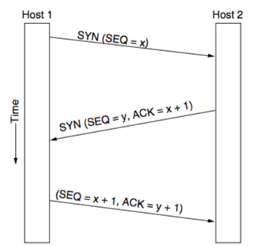
TCP Connection Establishment
How to choose the initial sequence number?
Protect delayed duplicates, do now generate the initial sequence number for every connection from 0
Original implementation of TCP used a clock based approach, the clock ticked every 4 microseconds, the value of the clock cycles from 0 to 2³²-1. The value of the clock gives the initial sequence number
TCP SYN flood attack
Solution: Use cryptographic function to generate sequence numbers

Slide 12
TCP Connection Release

Slide 13
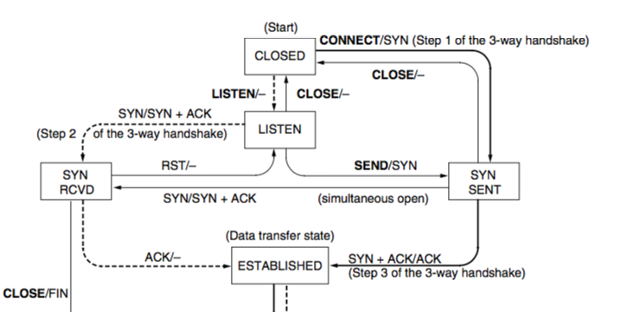
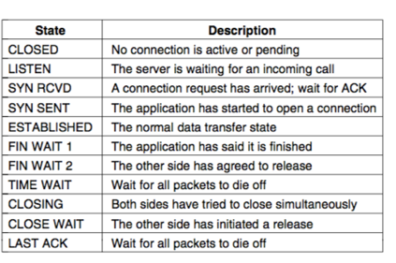
TCP State Transition Diagram – Connection Modeling
Event/Action
Dashed: Server
Solid: Client
Source: Computer Networks (5th Edition) by Tanenbaum, Wetherell

Slide 14
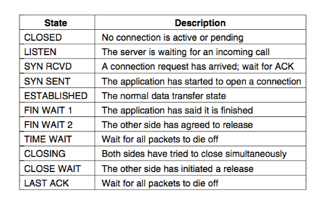
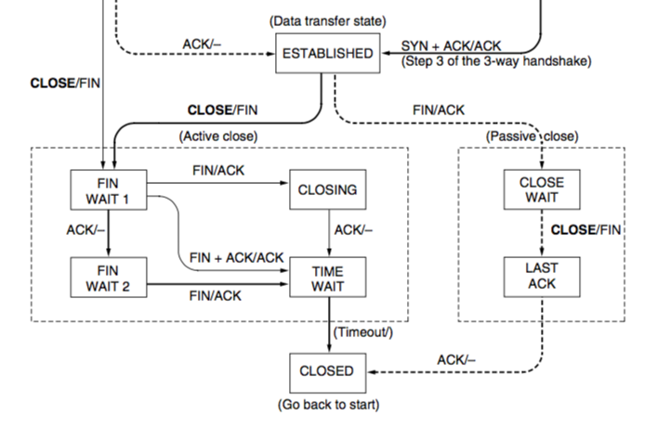
TCP State Transition Diagram – Connection Modeling
Source: Computer Networks (5th Edition) by Tanenbaum, Wetherell
Event/Action
Dashed: Server
Solid: Client

Slide 15
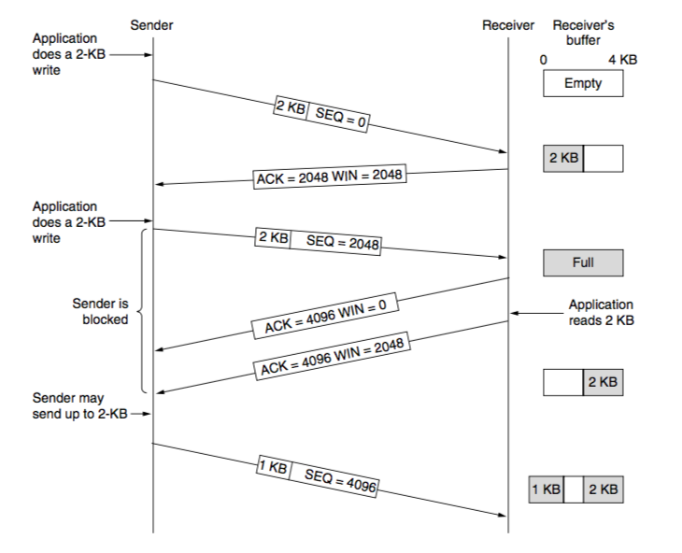
TCP Sliding Window
Source: Computer Networks (5th Edition) by Tanenbaum, Wetherell

Slide 16
Delayed Acknowledgements
Consider a telnet connection, that reacts on every keystroke.
In the worst case, whenever a character arrives at the sending TCP entity, TCP creates a 21 byte TCP segment, 20 bytes of header and 1 byte of data. For this segment, another ACK and window update is sent when the application reads that 1 byte. This results in a huge wastage of bandwidth.
Delayed acknowledgements: Delay acknowledgement and window updates for up to 500 msec in the hope of receiving few more data packets within that interval.
However, the sender can still send multiple short data segments.

Slide 17
Nagle’s Algorithm
When data come into the sender in small pieces, just send the first piece and buffer all the rest until the first piece is acknowledged.
Then send all buffered data in one TCP segment and start buffering again until the next segment is acknowledged.
Only one short packet can be outstanding at any time.
Do we want Nagle’s Algorithm all the time?
Nagle’s Algorithm and Delayed Acknowledgement
Receiver waits for data and sender waits for acknowledgement – results in starvation

Slide 18
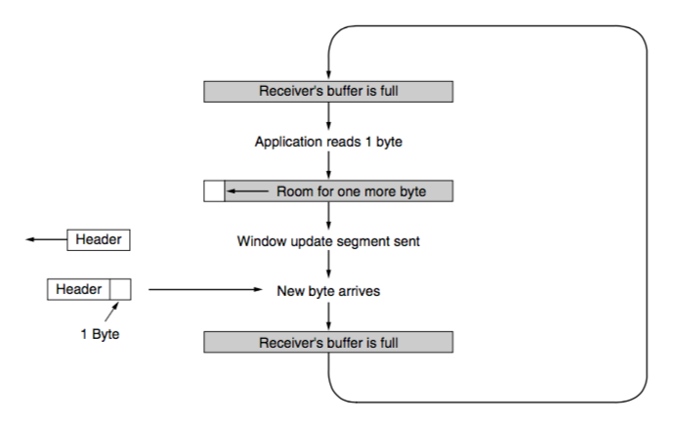
Silly Window Syndrome
Data are passed to the sending TCP entity in large blocks, but an interactive application on the receiver side reads data only 1 byte at a time.
Clark’s solution: Do not send window update for 1 byte. Wait until sufficient space is available at the receiver buffer.
Source: Computer Networks (5th Edition) by Tanenbaum, Wetherell

Slide 19
Handling Short Segments – Sender and Receiver Together
Nagle’s algorithm and Clark’s solution to silly window syndrome are complementary
Nagle’s algorithm: Solve the problem caused by the sending application delivering data to TCP a byte at a time
Clark’s solution: Receiving application fetching the data up from TCP a byte at a time
Exception: The PSH flag is used to inform the sender to create a segment immediately without waiting for more data

Slide 20
Handling Out of Order in TCP
TCP buffers out of order segments and forward a duplicate acknowledgement to the sender.
Acknowledgement in TCP – Cumulative acknowledgement
Receiver has received bytes 0, 1, 2, _, 4, 5, 6, 7
TCP sends a cumulative acknowledgement with ACK number 2, acknowledging everything up to byte 2
Once 4 is received, a duplicate ACK with ACK number 3 (next expected byte) is forwarded – triggers congestion control
After timeout, sender retransmits byte 3
Once byte 3 is received, it can send another cumulative ACK with ACK number 8 (next ecpected byte)

Slide 21
TCP Timer Management
TCP Retransmission Timeout (RTO): When a segment is sent, a retransmission timer is started
If the segment is acknowledged before the timer expires, the timer is stopped
If the timer expires before the acknowledgement comes, the segment is retransmitted
What can be an ideal value of RTO ?
Possible solution: Estimate RTT, and RTO is some positive multiples of RTT
RTT estimation is difficult for transport layer – why?

Slide 22
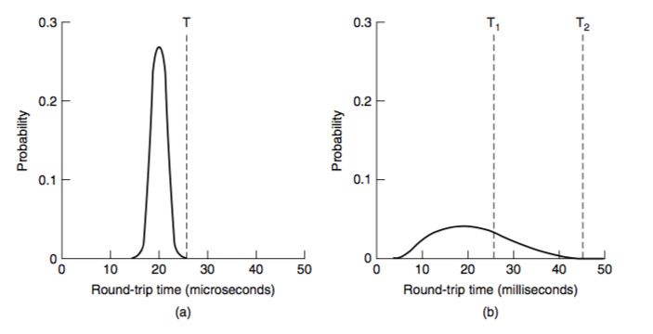
RTT at Data Link Layer vs RTT at Transport Layer
Data Link Layer
Transport Layer

Slide 23
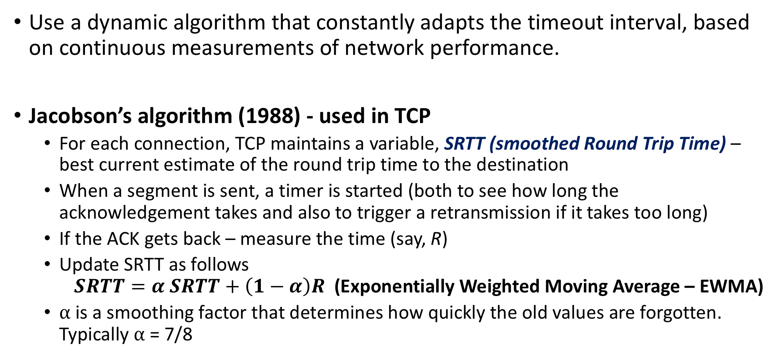
RTT Estimation at the Transport Layer
Use a dynamic algorithm that constantly adapts the timeout interval, based on continuous measurements of network performance.
Jacobson’s algorithm (1988) - used in TCP
For each connection, TCP maintains a variable, SRTT (smoothed Round Trip Time) – best current estimate of the round trip time to the destination
When a segment is sent, a timer is started (both to see how long the acknowledgement takes and also to trigger a retransmission if it takes too long)
If the ACK gets back – measure the time (say, R)
Update SRTT as follows $SRTT=α SRTT+\left(1−α\right)R$ (Exponentially Weighted Moving Average – EWMA)
⍺ is a smoothing factor that determines how quickly the old values are forgotten. Typically ⍺ = 7/8

Slide 24
Problem with EWMA
Even given a good value of SRTT, choosing a suitable RTO is nontrivial.
Initial implementation of TCP used RTO = 2SRTT
Experience showed that a constant value was too inflexible, because it failed to response when the variance went up (RTT fluctuation is high) – happens normally at high load
Consider variance of RTT during RTO estimation.

Slide 25
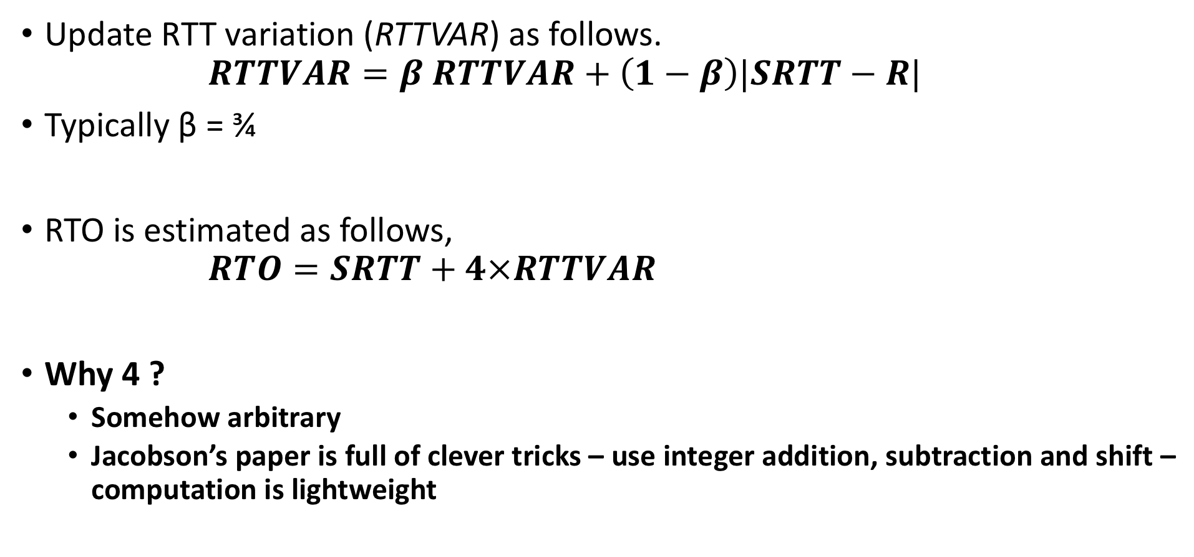
RTO Estimation
Update RTT variation (RTTVAR) as follows. $RTTVAR=β RTTVAR+\left(1−β\right)|SRTT−R|$
Typically β = ¾
RTO is estimated as follows, $RTO=SRTT+4×RTTVAR$
Why 4 ?
Somehow arbitrary
Jacobson’s paper is full of clever tricks – use integer addition, subtraction and shift – computation is lightweight

Slide 26
Karn’s Algorithm
How will you get the RTT estimation, when a segment is lost and retransmitted again?
Karn’s algorithm:
Do not update estimates on any segments that has been retransmitted
The timeout is doubled each successive retransmission until the segments gets through the first time

Slide 27
Other TCP Timers
Persistent TCP Timer: Avoid deadlock when receiver buffer is announced as zero
After the timer goes off, sender forwards a probe packet to the receiver to get the updated window size
Keepalive Timer: Close the connection when a connection has been idle for a long duration
TCP TIME_WAIT: Wait before closing a connection – twice the packet lifetime

Slide 28
TCP Congestion Control
Based on implementation of AIMD using a window and with packet loss as the binary signal
TCP maintains a Congestion Window (CWnd) – number of bytes the sender may have in the network at any time
Sending Rate = Congestion Window / RTT
Sender Window (SWnd) = Min (CWnd, RWnd)
RWnd – Receiver advertised window size

Slide 29
1986 Congestion Collapse
In 1986, the growing popularity of Internet led to the first occurrence of congestion collapse – a prolonged period during which goodput dropped precipitously (more than a factor of 100)
Early TCP Congestion Control algorithm – Effort by Van Jancobson (1988)
Challenged for Jacobson – Implement congestion control without making much change in the protocol (made it instantly deployable)
Packet loss is a suitable signal for congestion – use timeout to detect packet loss. Tune CWnd based on the observation from packet loss

Slide 30
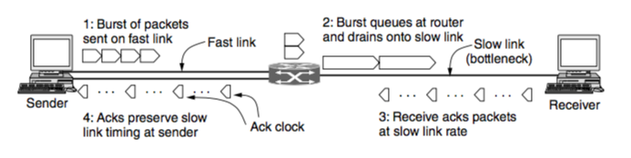
Adjust CWnd based on AIMD
One of the most interesting ideas – use ACK for clocking
ACK returns to the sender at about the rate that packets can be sent over the slowest link in the path.
Trigger CWnd adjustment based on the rate at which ACK are received.

Slide 31
Increase Rate Exponentially at the Beginning – The Slow Start
AIMD rule will take a very long time to reach a good operating point on fast networks if the CWnd is started from a small size.
A 10 Mbps link with 100 ms RTT
Appropriate CWnd = BDP = 1 Mbit
1250 byte packets -> 100 packets to reach BDP
CWnd starts at 1 packet, and increased 1 packet at every RTT
100 RTTs are required 10 sec before the connection reaches to a moderate rate
Slow Start - Exponential increase of rate to avoid slow convergence
Rate is not slow at all ! 😃
CWnd is doubled at every RTT

Slide 32
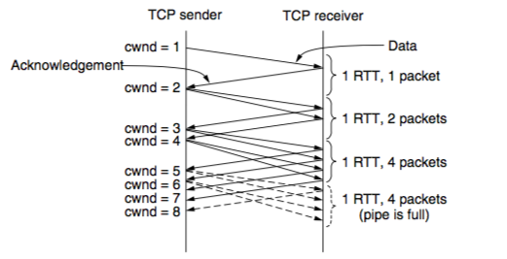
TCP Slow Start
Every ACK segment allows two more segments to be sent
For each segment that is acknowledged before the retransmission timer goes off, the sender adds one segment’s worth of bytes to the congestion window.

Slide 33
Slow Start Threshold
Slow start causes exponential growth, eventually it will send too many packets into the network too quickly.
To keep slow start under control, the sender keeps a threshold for the connection called the slow start threshold (ssthresh).
Initially ssthresh is set to BDP (or arbitrarily high), the maximum that a flow can push to the network.
Whenever a packet loss is detected by a RTO, the ssthresh is set to be half of the congestion window

Slide 34
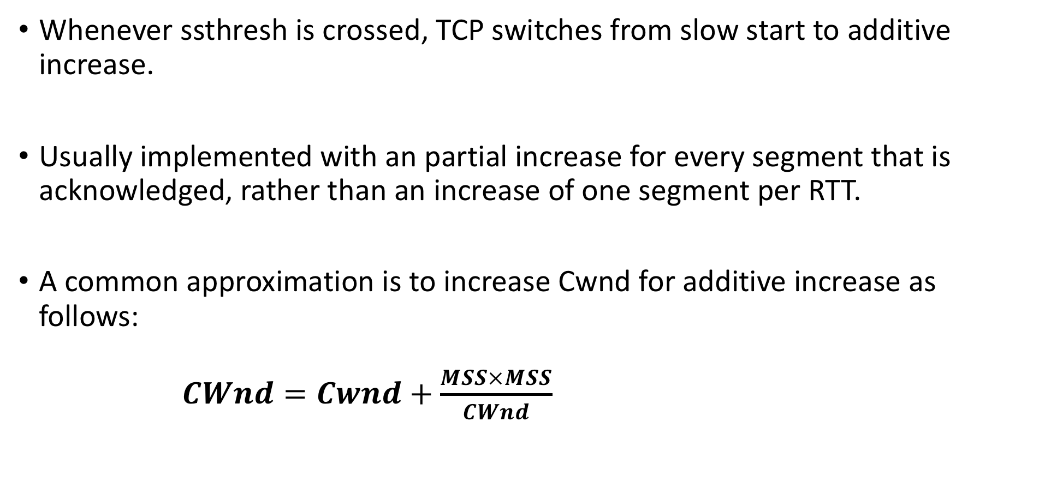
Additive Increase (Congestion Avoidance)
Whenever ssthresh is crossed, TCP switches from slow start to additive increase.
Usually implemented with an partial increase for every segment that is acknowledged, rather than an increase of one segment per RTT.
A common approximation is to increase Cwnd for additive increase as follows: $CWnd=Cwnd+\frac{MSS×MSS}{CWnd}$

Slide 35
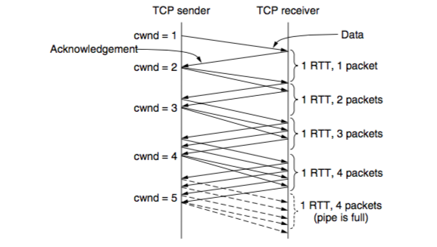
Additive Increase – Packet Wise Approximation

Slide 36
Triggering an Congestion
Two ways to trigger a congestion notification in TCP – (1) RTO, (2) Duplicate ACK
RTO: A sure indication of congestion, however time consuming
Duplicate ACK: Receiver sends a duplicate ACK when it receives out of order segment
A loose way of indicating congestion
TCP arbitrarily assumes that THREE duplicate ACKs (DUPACKs) imply that a packet has been lost – triggers congestion control mechanism
The identity of the lost packet can be inferred – the very next packet in sequence
Retransmit the lost packet and trigger congestion control

Slide 37
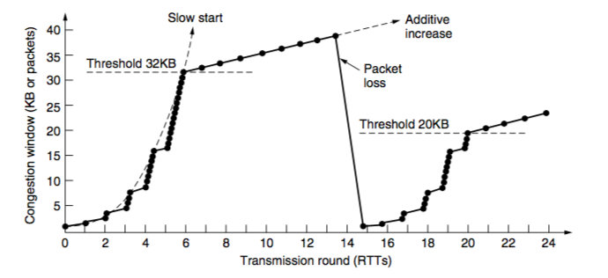
Fast Retransmission – TCP Tohoe
Use THREE DUPACK as the sign of congestion
Once 3 DUPACKs have been received,
Retransmit the lost packet (fast retransmission) – takes one RTT
Set ssthresh as half of the current CWnd
Set CWnd to 1 MSS

Slide 38
Fast Recovery – TCP Reno
Once a congestion is detected through 3 DUPACKs, do TCP really need to set CWnd = 1 MSS ?
DUPACK means that some segments are still flowing in the network – a signal for temporary congestion, but not a prolonged one
Immediately transmit the lost segment (fast retransmit), then transmit additional segments based on the DUPACKs received (fast recovery)

Slide 39
Fast Recovery – TCP Reno
Fast recovery:
set ssthresh to one-half of the current congestion window. Retransmit the missing segment.
set cwnd = ssthresh + 3.
Each time another duplicate ACK arrives, set cwnd = cwnd + 1. Then, send a new data segment if allowed by the value of cwnd.
Once receive a new ACK (an ACK which acknowledges all intermediate segments sent between the lost packet and the receipt of the first duplicate ACK), exit fast recovery. This causes setting cwnd to ssthresh (the ssthresh in step 1). Then, continue with linear increasing due to congestion avoidance algorithm.

Slide 40
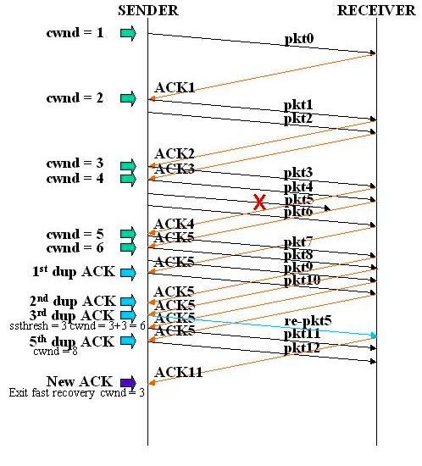
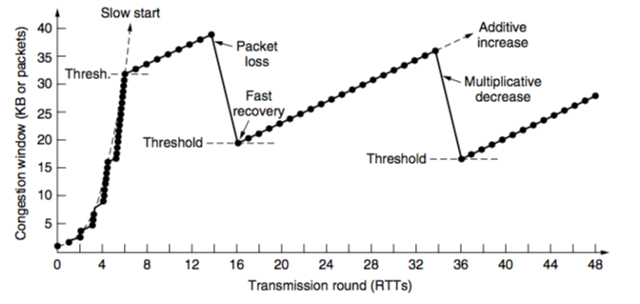
Fast Recovery – TCP Reno

Slide 41
This is a broad discussion of the Transport Layer … Next we’ll move to the discussion of Network layer and the IP Protocol

